Slide 1
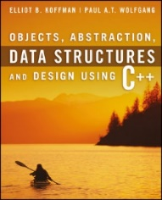
Welcome to
CS 235 Data Structures
Inheritance, 3.1-2 (09)

Slide 2
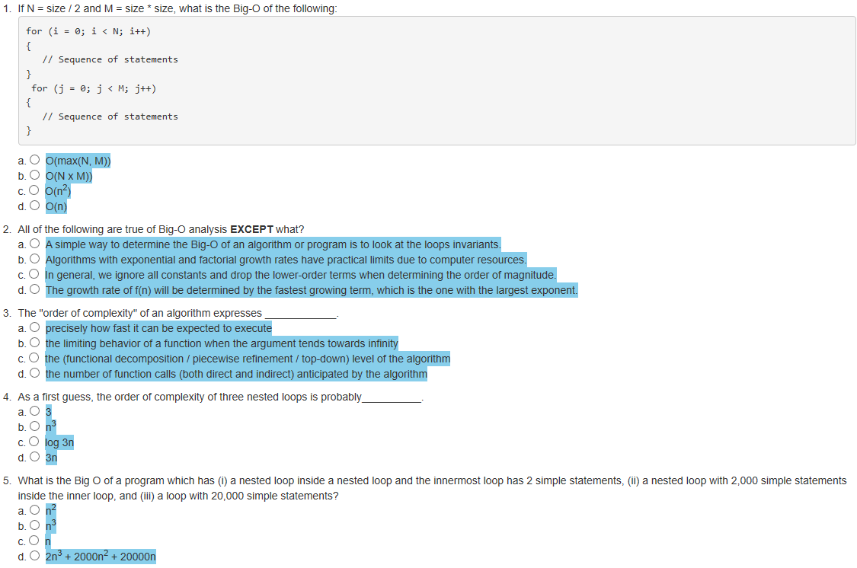
Attendance Quiz #08

Slide 3
Tip #09: Default Arguments
Default function parameters supply values when a user does not.
int add(int x, int y = 1) { return x + y; }
int main()
{
int result1 = add(5);
int result2 = add(5, 3);
return 0;
}
int add(int x, int y) { return x + y; }
int main()
{
int result1 = add(5); // Error
int result2 = add(5, 3);
return 0;
}
Advantages and Disadvantages.
In 99% of cases you don't need half of the function parameters.
With normal functions, default parameters can make code harder to read.
When refactoring, default parameters can be used to add functionality without breaking code.
Introduces problems reviewing or using code written by others - hidden parameters.
Some functions tend to have the same parameter values - default parameters supply those common values and also helps you see the "suggested" value.
**NOTE: google's coding style suggests avoiding them.

Slide 4
2.6 Efficiency of Algorithms
Big-O Notation
Comparing Performance
Algorithms with Exponential and Factorial Growth Rates
2.6, pgs. 170-179

Slide 5
Efficiency of Algorithms
Getting a precise measure of the performance of an algorithm is difficult.
We use the approximate effect of a change in the number of data items.
In this way we can see how an algorithm's execution time increases with respect to n, so we can compare two algorithms by examining their growth rate.
Even though computers are getting faster with larger memories, algorithm growth rates can be so large that no computer can solve the problem above a certain size.
Understanding how the execution time (and memory requirements) of an algorithm grows as a function of increasing input size gives programmers a tool for comparing various algorithms and determining how they will perform.
If the execution time stays the same regardless of the number of inputs, then the growth rate is constant or of order 1.
If the execution time approximately doubles when the number of inputs doubles, then the algorithm grows at a linear rate or a growth rate of order n.
If the execution time approximately quadruples when the number of inputs is doubled, then the algorithm grows at a quadratic rate or at a growth rate of order of n^{2.}

Slide 6
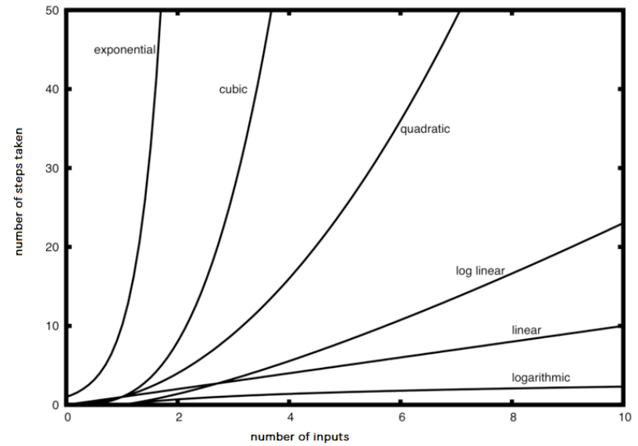
Big-O Notation
Computer scientists use the symbol O as an abbreviation for “order of magnitude” and is called big-O notation.
O(1) represents constant time
O(n) represents linear time
O(n × m) represents quadratic time
O(n²) also represents quadratic time
O(n log n) represents logarithmic time

Slide 7
Big-O Notation
A simple way to determine the big-O of an algorithm or program is to look at any loops and to see whether the loops are nested.
a single loop is O(n)
a nested loop is O(n²)
a nested loop in a nested loop is O(n³), and so on
The growth rate of f(n) will be determined by the fastest growing term, which is the one with the largest exponent.
In general, it is safe to ignore all constants and to drop the lower-order terms when determining the order of magnitude.
Basic Rules:
Nested loops are multiplied together.
Sequential loops are added.
Only the largest term is kept, all others are dropped.
Constants are dropped.
Conditional checks are constant (i.e., 1).

Slide 8
Big-O Example
void T(int n)
{
for(int i = 0; i < n; ++i)
{
for(int j = 0; j < n; ++j)
{
// Simple Statement;
}
}
for(int j = 0; j < n; ++j)
{
// Simple Statement 1;
// Simple Statement 2;
// Simple Statement 3;
}
// Simple Statement 1;
// ...
// Simple Statement 8;
// Simple Statement 9;
}
The outer loop will execute n times. The inner loop will execute n times for each outer loop iteration. (n²)
The loop will execute 3 Simple Statements n times. (3n)
Finally, 9 Simple Statements are executed. (9)
The relationship between processing time and n (the number of Simple Statements processed) is:
T(n) = n² + 3n + 9
The growth rate of f(n) will be determined by the fastest growing term, which is the one with the largest exponent. In the example, an algorithm of O(n² + 3n + 9) is more simply expressed as O(n²).

Slide 9
What is the Big-O of the following:
// #1
for (int i = 0; i < n; ++i)
{
cout << i << endl;
}
// #5
for (int i = 0; i < size; ++i)
{
cout << arr[i] << endl;
}
for (int i = 0; i < size; ++i)
{
cout << arr[i] << endl;
}
O(n)
O(n)
// #2
{
cout << i << endl;
}
O(1)
// #3
for (int i = 0; i < n + 1; ++i)
{
for (int j = 1; j < n; j *= 2)
{
//do swap stuff, constant time
}
}
// #6
for (int i = 0; i < size; ++i)
{
cout << a[i] << endl;
}
for (int i = 0; i < size; ++i)
{
for (int j = 0; j < size; ++j)
{
cout << a[i] + a[j] << endl;
}
}
O(n²)
O(n log n)
// #4
int fib(int num)
{
if (num <= 1) return num;
return fib(num - 2) + fib(num - 1);
}
O(2^{n})

Slide 10
Lab 02 - SNAP

Slide 11
S.N.A.P Lab
Class design is type design - defining effective classes can be challenging.
Organize related data into structures (structs or classes).
Make a member function only if access to internals of a class is needed.
Minimize exposure of class members by making public for the general use, protected for derived classes and the remaining members should be private.
For the SNAP lab you are to design classes for a school database with has-a and is-a relationships that have natural syntax, intuitive semantics, and efficient memory allocation.
The class objects are populated from parsed input strings.
Use object inheritance, polymorphism, and function and operator overloading where needed.
All member data and internal functions are private.
All classes have a "toString" method with friends for the insertion ("<<") operator.
Use UML diagrams to describe your implementation.

Slide 12
Example SNAP Input/Output
Input Strings:
snap(12345,Charlie Brown,Manager,555-1234).
snap(67890,Lucy,Right Field,555-5678).
csg(CS101,12345,A).
csg(CS101,67890,B).
**Error: csgs(CS101,67890,B).
cdh(CS101,M,9AM).
cdh(CS101,W,9AM).
cr(CS101,1170 TMCB).
Vectors:
snap(12345,Charlie Brown,Manager,555-1234)
snap(67890,Lucy,Right Field,555-5678)
csg(CS101,12345,A)
csg(CS101,67890,B)
cdh(CS101,M,9AM)
cdh(CS101,W,9AM)
cr(CS101,1170 TMCB)
Course Grades:
CS101,Charlie Brown,A
CS101,Lucy,B
Student Schedules:
Charlie Brown, 12345, Manager, 555-1234
CS101 MW 9AM, 1170 TMCB
Lucy, 67890, Right Field, 555-5678
CS101 MW 9AM, 1170 TMCB
studentId, name, address, phone #
course, studentId, grade
Use try/catch to report Input Error
course, day, hour
course, room
List snap, csg, cdh, and cr objects stored in vectors
List course grades (in snap vector order) for all students.
List all student schedules (in csg vector order.)

Slide 13
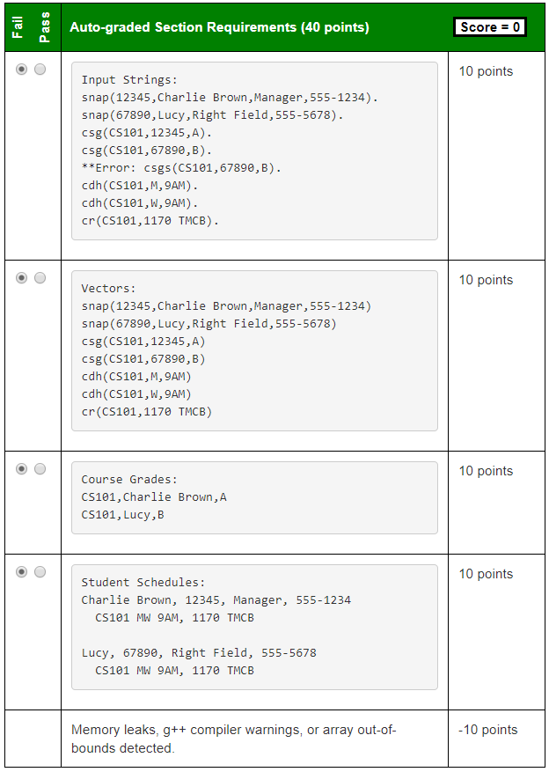
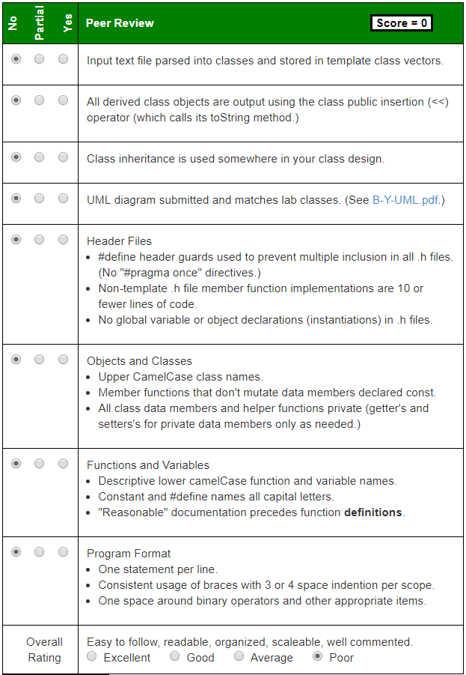
vector<Snap> snaps;
vector<Csg> csgs;
vector<Cdh> cdhs;
vector<Cr> crs;
studentId, name, address, phone #
course, studentId, grade
course, day, hour
course, room
string toString() const
{ stringstream out;
out << "snap(" << this->studentId;
out << "," << this->studentName;
out << "," << this->studentAddress;
out << "," << this->studentPhone << ")";
return out.str();
}
friend ostream& operator<< (ostream& os, const Snap& snap)
{
os << snap.toString();
return os;
}
Use try/catch to report Input Error
List snap, csg, cdh, and cr objects stored in vectors
List course grades (in snap vector order) for all students.
List all student schedules (in csg vector order.)
Create pdf or jpg of UML diagram – must be of reasonable size (< ~4M.) Zip pdf, or jpg in submission folder. Not required to include friends in UML diagram.

Slide 14
UML
Vehicle
Class Name
The data members and functions are listed by visibility, name, and type.
Visibility
A '-' indicates private visibility.
A '+' indicates public visibility.
A '#' indicates protected visibility.
Type
Data member, function parameter and return types appear after the name.
-vid:int
-make:string
Data Members
+Vehicle(mk:string, vid:int)
+~Vehicle()
+getVID():int
+getMake():string
+toString():string
Class Methods
public
private
is-a
Car
has-a
-model:string
-engine:Engine
Engine
+Car(mk:string, mdl:string,
vid:int, cyl:int)
+getModel():string
+getEngine():Engine&
+toString():string
-cylinders:int
+Engine(cyl:int)
+getCylinders():int
+toString():string

Slide 15
SNAP Inheritance
Student
Course
-int studID
-string course
+int getStudID()
+toString() const
+string getCourse()
+toString() const
SNAP
Csg
Cdh
Cr
-int studID
-string name
-string address
-string phone
-string course
-int studID
-string grade
-string course
-string day
-string hour
-string course
-string room
+string getCourse()
+string getRoom()
+toString() const
+string getCourse()
+int getStudID()
+string getGrade()
+toString() const
+string getCourse()
+string getDay()
+string getHour()
+toString() const
+int getStudID()
+string getName()
+string getAddr()
+string getPhone()
+toString() const

Slide 16
SNAP Inheritance
This process is known as refactoring and is often used in object-oriented design.
Student
Course
-int studID
-string course
+int getStudID()
+toString() const
+string getCourse()
+toString() const
SNAP
Csg
Cdh
Cr
-int studID
-string name
-string address
-string phone
-string course
-int studID
-string grade
-string course
-string day
-string hour
-string course
-string room
+string getCourse()
+string getRoom()
+toString() const
+string getCourse()
+int getStudID()
+string getGrade()
+toString() const
+string getCourse()
+string getDay()
+string getHour()
+toString() const
+int getStudID()
+string getName()
+string getAddr()
+string getPhone()
+toString() const
Please carefully read and follow the Lab requirements!

Slide 17
SNAP Inheritance
School
This process is known as refactoring and is often used in object-oriented design.
-string course
-int studID
+string getCourse()
+int getStudID()
+toString() const
SNAP
Csg
Cdh
Cr
-int studID
-string name
-string address
-string phone
-string course
-int studID
-string grade
-string course
-string day
-string hour
-string course
-string room
+string getCourse()
+string getRoom()
+toString() const
+string getCourse()
+int getStudID()
+string getGrade()
+toString() const
+string getCourse()
+string getDay()
+string getHour()
+toString() const
+int getStudID()
+string getName()
+string getAddr()
+string getPhone()
+toString() const
Please carefully read and follow the Lab requirements!

Slide 18
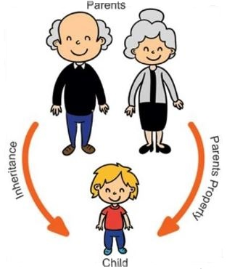
3.1 Introduction to Inheritance and Class Hierarchies
Is-a Versus Has-a Relationships
A Base Class and a Derived Class
Initializing Data Fields in a Derived Class
The No-Parameter Constructor
Protected Visibility for Base-Class Data Fields
3.1 Introduction to Inheritance and Class Hierarchies

Slide 19
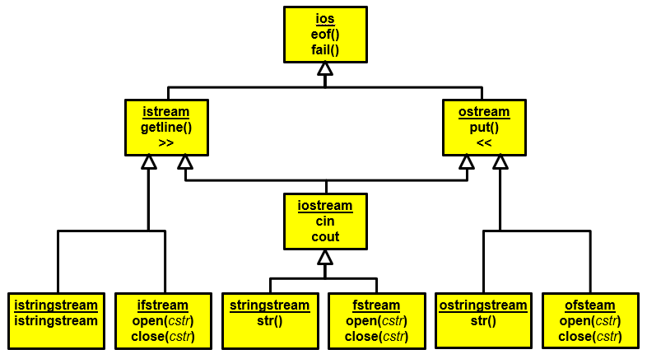
Inheritance and Class Hierarchies
Object-Oriented Programming (OOP) enables programmers to reuse previously written code saved as classes.
Code reuse reduces the time required to code new applications.
Previously written tested and debugged code enables new applications to be more reliable.
In OOP, a programmer can create a similar class by extending an existing class, rather than by writing an entirely new class.
The new class (called the derived class or subclass) can have additional data fields and member functions.
The derived class inherits the data fields and member functions of the original class (called the base class or superclass) or multiple parents.
A class hierarchy represents a set of hierarchically organized concepts.
Base classes typically act as interfaces.
Implementation inheritance
Interface inheritance.
If a base class is used as an interface, make it a pure abstract class.

Slide 20
Is-a Versus Has-a Relationships
The is-a relationship between classes means that every instance of one class is also an instance of the other class (but not the other way around).
A Ford is a vehicle, but not all vehicles are Fords.
The Ford class is derived from a Vehicle class.
The is-a relationship is represented in object oriented programming (OOP) by extending a class.
The has-a relationship (composition) between classes means that every instance of one class has one or more instances of the other class.
For example, a Ford vehicle has-a engine.
The has-a relationship is represented by declaring in a class a data field whose type is another class.

Slide 21
Is-a Versus Has-a Relationships
We can combine is-a and has-a relationships.
A Ford is-a vehicle and has-a engine.
The Ford inherits all the properties of a vehicle.
A vehicle has a VID, so a Ford does too because it is a vehicle.
C++ captures both the inheritance (is-a) relationship and the composition (has-a) relationship.
The part of the class heading following the colon specifies that Ford is a derived class of Vehicle.
class Ford : public Vehicle
{
private:
Engine engine; // Ford automobiles have an engine
public:
};
The Engine data field stores information for a Ford object.

Slide 22
A Base Class and a Derived Class
A computer has a:
manufacturer
processor
RAM
disk
A laptop computer is a kind of computer, so it has all the properties of a computer plus some additional features:
screen size
weight
Computer
-manufacturer:string
-processor:string
-ramSize:int
-diskSize:int
We can define class LapTop as a derived class of base class Computer.
+getRamSize() const:int
+getDiskSize() const:int
+toString() const:string
LapTop
"A LapTop is-a Computer"
-screenSize:int
-weight:double
+getScreenSize() const:int
+getWeight() const:double

Slide 23
Computer Class
Computer.h
Computer.cpp
#ifndef COMPUTER_H_
#define COMPUTER_H_
#include <string>
class Computer
{
private:
std::string manufacturer;
std::string processor;
int ramSize;
int diskSize;
public:
Computer(const std::string& man,
const std::string& proc,
int ram, int disk) :
manufacturer(man),
processor(proc),
ramSize(ram),
diskSize(disk) {}
int getRamSize() const { return ramSize; }
int getDiskSize() const { return diskSize; }
std::string toString() const;
};
#endif
#include "computer.h"
#include <sstream>
using std::ostringstream;
using std::string;
using std::endl;
string Computer::toString() const
{
ostringstream sb;
sb << "Manufacturer: " << manufacturer
<< endl << "CPU: " << processor
<< endl << "RAM: " << ramSize << " Mbs"
<< endl << "Disk: " << diskSize << " Gbs";
return sb.str();
}
4 private data elements common to all computers.
Small in-line member functions are included in the .h file (<= 10 lines).
Larger class implementations are often found in a corresponding .cpp file.

Slide 24
Class LapTop
LapTop.h
#ifndef LAP_TOP_H
#define LAP_TOP_H
#include <string>
#include <sstream>
#include "computer.h"
using std::string;
using std::ostringstream;
class LapTop : public Computer
{
private:
int screenSize;
double weight;
public:
LapTop(const string& m,
const string& p,
int r, int d, int s, double w) :
Computer(m, p, r, d),
screenSize(s), weight(w) {}
int getScreenSize() const { return screenSize; }
double getWeight() const { return weight; }
};
#endif
Class LapTop is derived from class Computer and publicly inherits Computer's data members and member functions.
In the definition of a constructor of a class, member initializer list specifies the initializers for direct and virtual base subobjects and non-static data members.
The constructor for class LapTop must begin by initializing the four data fields inherited from class Computer.
Because those data fields are private to the base class, C++ requires that they be initialized by a base class constructor.

Slide 25
Computer Class
Computer.h
LapTop.h
class Computer
{
protected:
std::string manufacturer;
private:
std::string processor;
int ramSize;
int diskSize;
public:
// ...
};
class Computer
{
private:
std::string manufacturer;
std::string processor;
int ramSize;
int diskSize;
public:
// ...
};
class LapTop : public Computer
{
private:
// ...
public:
void setManufacturer(std::string m)
{
manufacturer = m;
}
// ...
};
C++ provides a less restrictive form of visibility called protected visibility to allow a derived class to directly access data fields declared in its base class
Illegal!! The data fields inherited from class Computer have private visibility—they can be accessed only within class Computer.

Slide 26
Public, Protected, Private Inheritance
class A
{
public:
int x;
protected:
int y;
private:
int z;
};
class B : public A
{
// x is public
// y is protected
// z is not accessible from B
};
class C : protected A
{
// x is protected
// y is protected
// z is not accessible from C
};
class D : private A
{
// x is private
// y is private
// z is not accessible from D
};
Classes B, C and D all contain the variables x, y and z. It is just question of access.
'private' is default for classes

Slide 27
The No-Parameter Constructor
If the execution of any constructor in a derived class does not invoke a base class constructor, C++ automatically invokes the no-parameter constructor for the base class.
C++ does this to initialize the part of the object inherited from the base class before the derived class starts to initialize its part of the object.

Slide 28
Be Safe

